Slide 1
IFA European Region in collaboration with EATLP
The EU Pillar 2 and its International Ramifications
15 March 2023

Slide 2
The framework of the Directive and its challenges

Slide 3
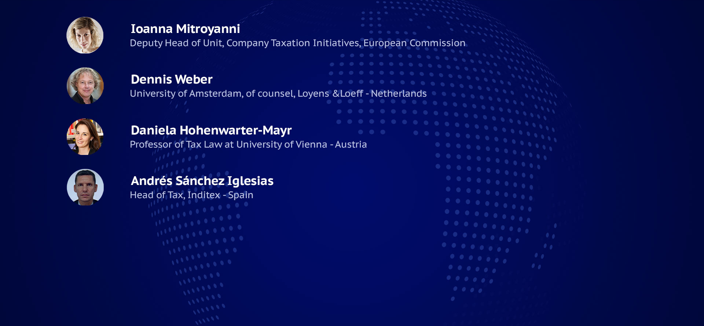
The framework of the directive and its challenges
IFA©2023

Slide 4
GloBE Model Rules & the EU Directive: main differences

Slide 5
Discussion
Interpretation of the Directive and evolution of the commentaries provided by the Inclusive Framework

Slide 6
Pillar Two: MNE view on implementation

Slide 7
Pillar Two: MNE view
Process to implement Pillar Two:
  Identifying perimeter: UPE, IPE/POPE and CE
  Financial Information:
    General Accepted Accounting Principles: IFRS
    Financial Accounting Net Income or Loss: aggregated info
    IAS 12: Top-up Tax included? Interim periods public entities?
    Effective Tax Rate: accounting vs. globe rules
    Proposal Exposure Draft IASB:
    - exception for DTA´s and DTL´s

Slide 8
Pillar Two: MNE view
Process to implement Pillar Two:
  Financial Information:
    Proposal Exposure Draft IASB:
        legislation enacted or substantially enacted
        disclosure jurisdictions: expected to pay ETR
  Filing obligation:
    UPE vs. designated CE: need to make it simple
    Qualifying Competent Authority Agreement

Slide 9
Pillar Two: MNE view
Process to implement Pillar Two:
  Filing obligation:
    Globe Information Return:
      UPE/CE, TIN, Residence and Status
      Corporate Structure
      ETR per jurisdiction and Top-up Tax per CE
      Allocation of Top-Up Tax per jurisdiction (IIR/UTPR)
      Elections
      Others

Slide 10
Pillar Two: MNE view
Process to implement Pillar Two:
  Design of MNE internal process:
    Tax Department task? Tax Accounting skills?
    Two layers of taxation:
      Local CIT tax return and QDMTT: local subsidiaries
      Top-up Tax and GIR: UPE/POPE/IPE
    IT developments
    Centralization vs. decentralization
    Outsourcing vs. internal resources

Slide 11
Pillar Two: MNE view
Estimation of Pillar Two impact for MNE:
  No relevant impact
  Few jurisdictions with CIT nominal rate below 15%
  Most of them to implement 15% for MNE +750 m. EUR

Slide 12
Compatibility issues
EU Fondamental rights
GloBE Directive vs Tax treaties : Are we off the hook?

Slide 13
Directive must be in line with primary law
Pillar 2 Directive also applicable in domestic situations
Commission/EU Council : to prevent discrimination under right of establishment
Most likely based on Cadbury Schweppes, Lexel and Eurowings cases
  Unilateral discrimination measure cannot “tax away” tax advantages by another Member State
    No justification based on the allocation of taxing rights
    Only justified when wholly artificial

Slide 14
CJEU : EU Legislature : broad discretion
RPO case (VAT)
  For tax measures
  EU legislature : political, economic and social choices, and to rank divergent interests or to undertake complex assessments
  Limited to review if there is a manifest error

Slide 15
Infringements are limited
Question
  Is there a “manifest error”?
  EU legislator cannot oversee everything
Right to property (art. 17 EU Charter of fundamental rights)
  Hindering profit operation : could not be in line with right to property
  “Excessive tax burden” – minimum profit (ECHR)

Slide 16
What about tax treaty obligations?
Art. 351 TFEU
Assumptions:
Top-up taxes = covered tax
Conflict in substance
No treaty overrides under national (const.) legal order
 | MS (inter se) | Third countries
MS pre-accession treaties
MS post-accession treaties
Supremacy of EU law International law obligation (silently) remains
Art. 351(1) protection ✓
Art. 351(2) obligation to renegotiate/terminate treaty
Supremacy of EU law International law obligation (silently) remains
Supremacy of EU law (for MS)
International law obligation remains
Mutatis mutandis application of Art. 351(1) and (2)
to subsequently adopted secondary law?
Inspired by V. Bendlinger, in Smit & Herzog on the Law of the EU, § 351.07

Slide 17
Where are the practical problems?
High uncertainty ⇨ danger of fragmented application
Pre-accession tax treaty with third country
Substantive scope similar to Art 2 MC
No saving clause similar to Art 1(3) MC
Static treaty interpretation
  Restrictive approach to CFC legislation
  Relevance of non-discrimination clauses
Similar treatment of IIR/UTPR and CFC-Rules
No treaty override under constitutional principles
Protective scope of Art. 351 is extended to post-accession or amended pre-accession treaties with respect to subsequent directive based on
Art. 115 TFEU? ⇨ CJEU
Solution: MLC safeguard clause*
*V. Chand et al, WTJ 2022, 47; De Broe, Intertax 2022, 885 et seq.

Slide 18
The role of tax incentives and the impact on third countries MNEs

Slide 19
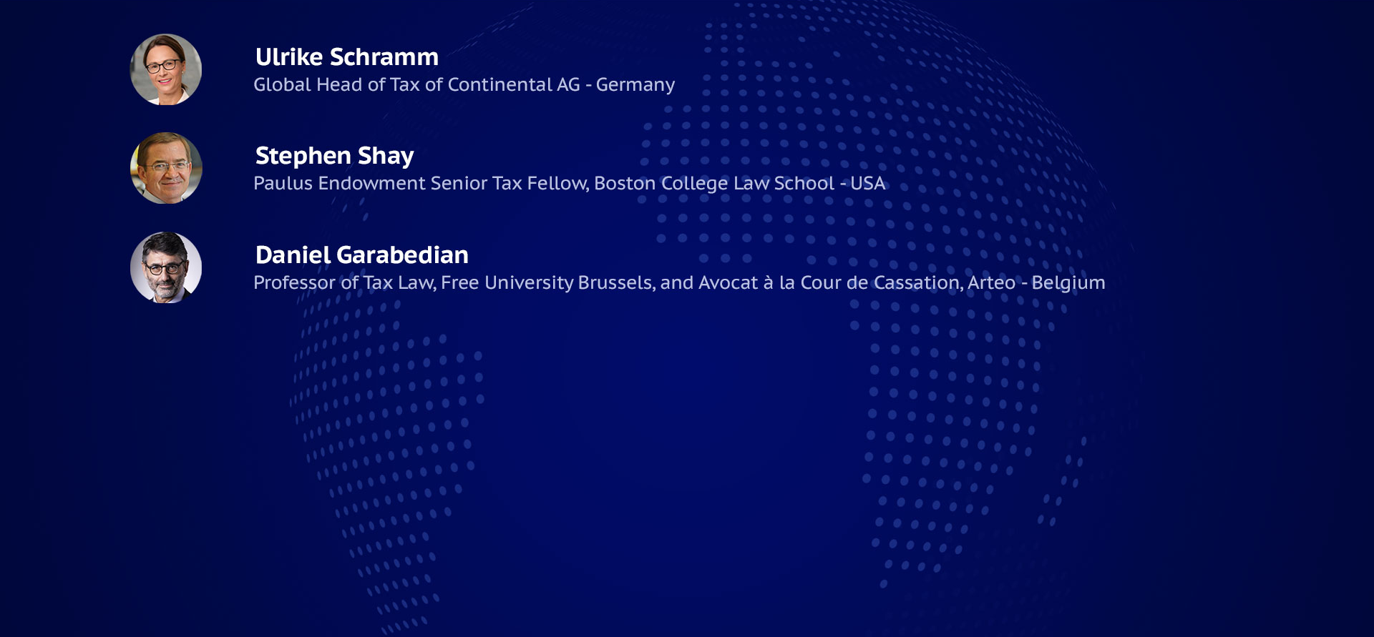
The role of tax incentives and the impact on third countries MNEs
IFA©2023

Slide 20

Safe harbours and tax incentives from an MNE’s perspective

Slide 21
1. Safe Harbours: Introduction
Transitional CbCR Safe Harbours per jurisdiction (FY24 – FY26)
De-Minimis Test
Simplified ETR Test
Routine Profit Test
Total Revenue < EUR 10m
&
EBT < EUR 1m
Simplified ETR
≥
15% / 16% / 17%
(2024 / 2025 / 2026)
EBT
≤
Substance-based Income Exclusion (SBIE) Amount
or
or
EBT / Revenue as per CbCR
Covered Taxes / SBIE as per FS
  Certain adjustments required

Slide 22
1. Safe Harbours: A Business Perspective
Transitional CbCR Safe Harbours
  Requirement of Qualified Financial Statements
  Potential deviation from expected ETR
  Reversal of impairments
  Reorganizations
  Capital gains from share deals
  Once-out-always-out approach
  (Partial) use of existing CbCR-Data
  Full consideration of deferred taxes
  Loss-making jurisdictions per se excluded
  Simplification for NMCEs
Significant Reduction of compliance work?

Slide 23
1. Safe Harbours: A Business Perspective
Permanent Safe Harbours
OECD Approach
De-Minimis, Simplified ETR and Routine Profit Test, but
  based on simplified Income, Revenue and Tax calculation
  still to be determined in Agreed Administrative Guidance
Proposal
  OECD White-List: qualification of world-wide tax systems on a regular basis
  At Least: White-List for countries with QDMTT
  Alternative: Continuation of CbCR Safe Harbours
>> Fast decision on permanent simplifications required
1
2
3

Slide 24
2. Tax Credits: Introduction
* Technically, in addition to treat the tax credit as GloBE income, Covered Taxes are increased if tax credit was reflected as reduction of current taxes.
Qualified
Refundable Tax Credit
Non-Qualified
Refundable Tax Credit
ETR
Adjusted Covered Taxes
GloBE Income / Loss
*
Qualified Refundable Tax Credit
means a refundable tax credit designed in a way such that
  it must be paid as cash or available as cash equivalents
  within four years from when a CE satisfies the conditions for receiving the credit under the laws of the jurisdiction granting the credit. […]
Non-Qualified Refundable Tax Credit
means a tax credit that is not a Qualified Refundable Tax Credit but that is refundable in whole or part.

Slide 25
2. Tax Credits: A Business Perspective
1
Evaluation case-by-case
Standardized questionnaires
Country-specifics
Room for interpretation
4
Impact on investment decisions
Risk of past investments turn unprofitable
Pillar 2 to impact future investment
Qualification
2
Tax Credit Schemes
Tax credit carry forward
Common mechanism
Refundable vs. Non-refundable
Timing of utilization
5
Incentive Landscape
Modification of existing tax credit toolkits expected
Increasing importance of non-tax schemes
3
Limitation of administrative work
“White- / Blacklist” by OECD of world-wide tax credit schemes

Slide 26
Pillar 2 impact with respect to tax incentives
Belgium as an example

Slide 27
Tax Incentives in a Non-Low Tax Jurisdiction
ETR in a jurisdiction is based on fraction
Adjusted Covered Taxes
Net Qualifying Income
Belgium:
  25% nominal CIT rate — Broad tax base
  But significant Tax Incentives, mainly focused on R&D — Strong
  biopharmaceutical industry, among others

Slide 28
Income Exemption
The “Innovation Income Deduction” (IID)
(cf. BEPS Action 5)
Belgian Entities are exempt from CIT on 85% of the net income they derive from
certain IP rights — Exemption however limited by the “nexus fraction”
Theoretically, this incentive could bring the ETR down to 3.75%
  25% x ( 100 - 85) = 3.75
ETR around 10% more realistic, because of the nexus fraction

Slide 29
Income Exemption
Gap between ETR and 15% will be covered by the QDMTT
Still a 10% tax rate reduction compared to the statutory 25% rate
Jurisdictional blending
Substance-based income exclusion
De minimis exclusion
Entities not within the scope of Pillar 2 could still benefit fully from the deduction

Slide 30
Tax Credit
Tax credit for R&D investments
Computed on the cost of environment-friendly investments in R&D and patents
Example: qualifying investment of 100 in a patent
100 x 13.5% x 25% = 3.375 tax credit
Deducted from CIT, carried-over and refundable after five years

Slide 31
Tax Credit
Because refundable after five years only, reduces the Covered Taxes (not a “qualified refundable tax credit”)
Covered Taxes 25 - 15
  Qualifying income 100
If refundable after four years, becomes a “qualified refundable tax credit”
  Covered Taxes 25
  Qualifying income 100 + 15
ETR = 10%
ETR = 21.7%

Slide 32
Reduction of other Taxes
Payroll Tax Exemption
The employer can keep 80% of the PIT WHT applicable on qualified salaries
Not a reduction of Covered Taxes
Same mechanics as a taxable subsidy:
—> increases the taxable income under the CIT
—> does not decrease the ETR

Slide 33
The Perspective of Developing Countries
How are developing countries affected? It depends for each country:
    How many MNE groups with an annual turnover of over EUR 750 million have constituent entity(ies) (CEs) with > EUR 1M income and EUR 10M revenues with ≤ 15% country ETR and net income > SBIE?

Slide 34
The Perspective of Developing Countries
Updated OECD global Pillar 2 revenue estimates:
2018 data: global estimated gains of USD 175B to USD 261B, with a central estimate of USD 220B (up from USD 175B based in 2017 data).
  N.B., assumes consistent application of GloBE rules across all jurisdictions; only low-taxed profit in low-tax jurisdictions modelled, evidence that much is in high-tax jurisdictions
  No jurisdiction-group level model or estimates, dependent on jurisdictional responses (QDMTTs).

Slide 35
The Perspective of Developing Countries
For L-MICs Is Pillar 2 - worth it? For how long? Is Pillar 1 required?
Potential QDMTT? UTPR?
  Revenue?
  Stabilization?
Impact on incentives? (See next slide)
Impact on investment?

Slide 36
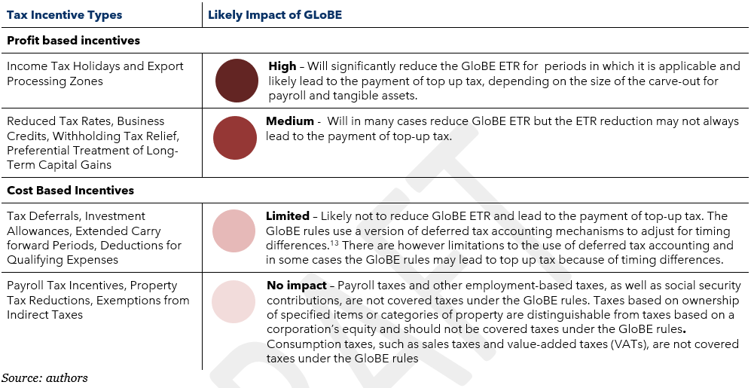
The Perspective of Developing Countries
IISD and ISLP, A Guide for Developing Countries on How to Understand and Adapt to the Global Minimum Tax (Consultation draft)

Slide 37
The Perspective of the United States
Biden FY 2024 Budget proposes Pillar 2 comparable (not exactly conforming)
  GILTI rate increase to 21%; repeal of QBAI
  Replacement of BEAT with UPTR (and QDMTT)
No realistic chance of passage before 2025.
Material uncertainty regarding implementation of Pillar 1 – treaty (2/3rds of Senate) or executive agreement (need legislation to authorize).

Slide 38
The Perspective of the United States
Pillar 2 compromise on allocation of CFC taxes in “blended CFC tax regime” and QDMTT priority over CFC taxes viewed favorably.
Treatment of transferable credits still unclear, but likely favorable from US perspective – material political issue.
Another political issue is whether other countries will comply.
US MNEs are modelling how they will be affected.

Slide 39
Dispute resolution issues
R. Danon, G. Maisto and A. Martín Jiménez

Slide 40
Dispute resolution for Pillar 2 and EU Law (1)
The OECD Context
What solution?
The domestic law solution by Danon, Gutmann, Maisto and Martín Jiménez?
  Domestic law provision
  Architecture
  Elements

Slide 41
-
- Will the solution depend on what the OECD does (MTC v. domestic law provision)?
-Is a specific solution for Pilar 2 Directive needed?
- The third country problem
Dispute Resolution for Pilar 2 and EU law: open questions
  dis-

